Slide 1

Capstone Project

Slide 2



Personal BACKGROUND
(Name, Past Experience, Qualification, Career Summary)
Name :
Ashwanth M
Past Experience :
Fresher
Qualification :
B.E Computer Science And Engineering
Career Summary : I recently completed a B.E. in Computer Science and Engineering and am currently focused on learning backend engineering. My academic background provided a solid foundation in software development, and I am now building expertise in server-side programming, database management, and API development. I am eager to apply my skills in backend development roles and contribute to impactful projects.
www.collaberadigital.com

Slide 3


Key Takeaways/Learnings from the Program (HTD)
During my training period:
I gained a comprehensive understanding of Spring Boot applications and related technologies. I learned how to work with Spring Boot, Spring Data JPA, and RESTful services, which helped me understand the foundations of modern web application development. I also delved into exception handling and various design patterns, which are crucial for building robust and maintainable applications.
In my capstone project:
I had the opportunity to apply these concepts in a practical setting. I worked on creating and managing entities, implementing service layers, and handling exceptions effectively within a real-world e-commerce application. This experience allowed me to solidify my knowledge and gain confidence in developing and deploying Spring Boot applications.

Slide 4

Problem Statement of the Capstone Project
The objective of this capstone project is to design and implement a robust e-commerce application using Spring Boot and Spring Data JPA. The application will serve as a platform for customers to browse, add products to a shopping cart, and place orders. It should handle various business scenarios, including managing customer information, product catalogs, shopping carts, and order processing, while maintaining data integrity and ensuring a seamless user experience.
Key requirements include:
Customer Management: The system should allow the creation, updating, retrieval, and deletion of customer information. Each customer will have a unique ID and associated details such as name, city, and pin code.
Product Catalog: The application must maintain a catalog of products, each identified by a unique ID, with details such as name, category, price, and available quantity.

Slide 5

Problem Statement of the Capstone Project
Shopping Cart: Customers should be able to add products to their shopping cart. The cart will contain multiple line items, each associated with a specific product, along with the quantity and total price for that item.
Order Processing: Once a customer decides to purchase, the application should allow the customer to place an order. Each order will include details such as the ordered products, their quantities, prices, and the total order value.
Data Persistence: All data should be persistently stored in a relational database, leveraging JPA for object-relational mapping.
Relationships and Constraints: The application should enforce relationships between entities, such as one-to-one (Customer to Cart), one-to-many (Order to OrderLineItem), and many-to-one (CartLineItem to Product), to ensure data consistency.
The final product should be a functional e-commerce backend that can handle these operations efficiently, laying the groundwork for potential future enhancements such as front-end integration, user authentication, and payment processing.

Slide 6
SPRING BOOT:
1. Simplified Configuration:
Auto-Configuration: Spring Boot automatically configures your application based on the dependencies you include. For example, if you include a database dependency, Spring Boot will configure a connection to that database automatically.
Application Properties: Configuration can be managed using application.properties or application.yml, allowing you to easily adjust settings like database URLs, server ports, and more.
2. Embedded Servers:
Embedded Tomcat/Jetty/Undertow: Spring Boot comes with embedded servers, meaning you don’t need to deploy your application to a standalone server. This makes development and deployment simpler and so on..
Spring Data JPA:
1. Simplified Data Access:
Repository Abstraction: Spring Data JPA provides a repository abstraction that simplifies data access. You can define interfaces for your repositories, and Spring Data JPA will automatically implement them. For example, JpaRepository provides CRUD operations and more.

Slide 7
2. Query Methods:
Derived Queries: You can create query methods in repository interfaces using method names that are automatically translated into SQL queries. For example, findByEmail(String email) will generate a query to find a user by email.
3. JPA Entity Management:
Entity Mapping: Spring Data JPA handles the mapping between Java objects and database tables. This means you define entities (e.g., Product, Order) as Java classes with annotations like @Entity and @Table.
4. Custom Queries:
@Query Annotation: Allows you to define custom queries using JPQL or SQL directly within repository methods. This is useful for complex queries that cannot be easily derived from method names.
5. Transaction Management:
Declarative Transactions: Spring Data JPA integrates with Spring's transaction management, allowing you to use annotations like @Transactional to manage transactions declaratively.

Slide 8
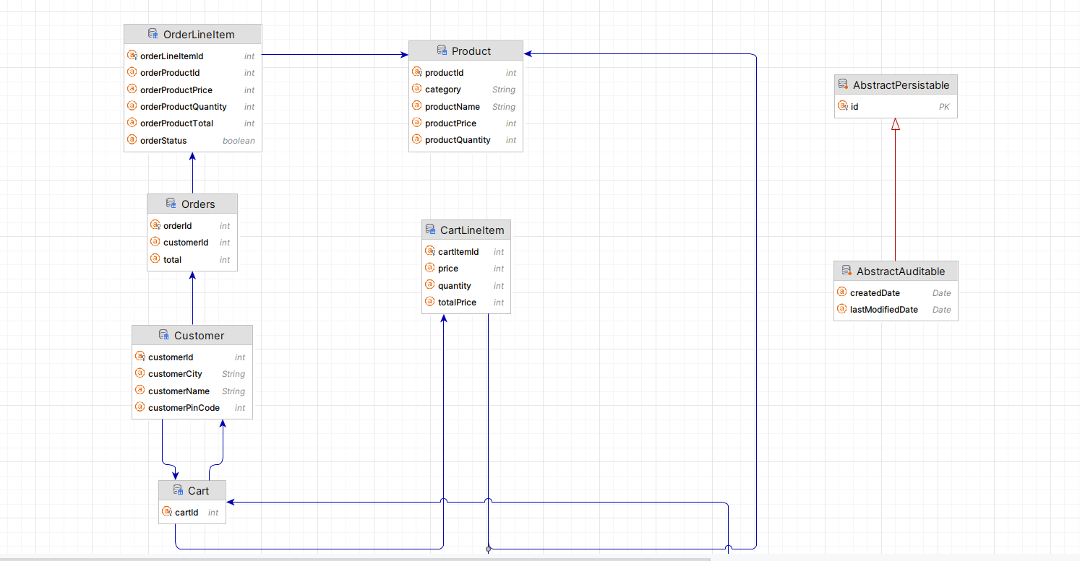
ENTITY CLASS DIAGRAM

Slide 9
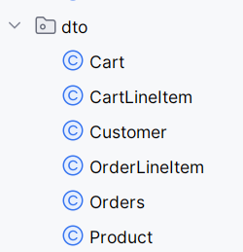
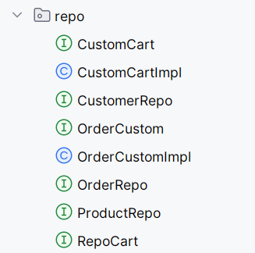
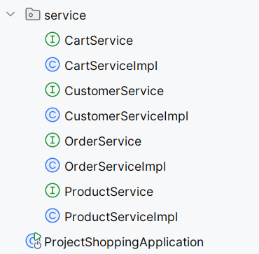
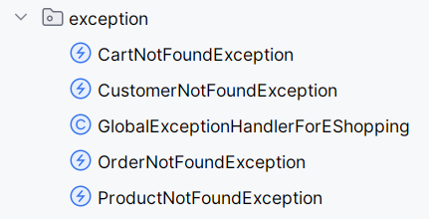
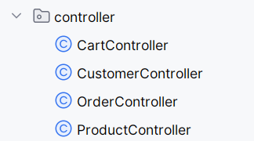
The DTO (Data Transfer Object) package in an e-commerce application contains several classes representing the core entities of the application. These entities are used to transfer data between different layers of the application.
The repository package in your Spring Boot e-commerce application contains interfaces and classes that manage the persistence of your data entities using JPA (Java Persistence API)
Each service is responsible for handling specific business logic related to the domain objects (Cart, Customer, Order, Product) and uses repositories to perform data operations. Exception handling is done where data might not be found.
The exception package contains custom exception classes for handling specific error scenarios in the application. Each exception class extends RuntimeException and is designed to signal the absence or unavailability of specific entities (like Cart, Customer, Order, or Product) when certain operations are attempted.

Slide 10
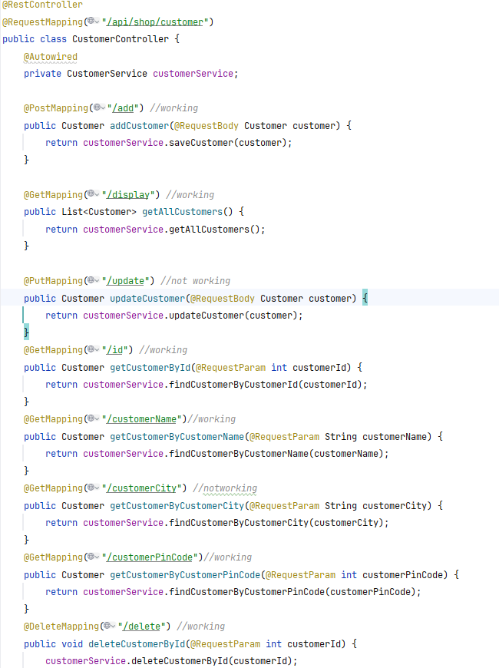
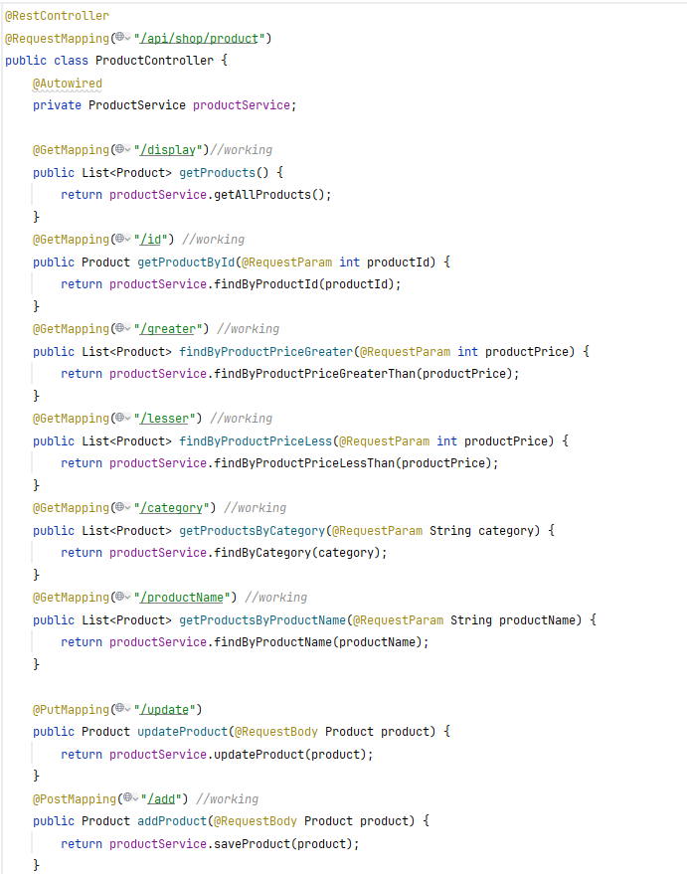
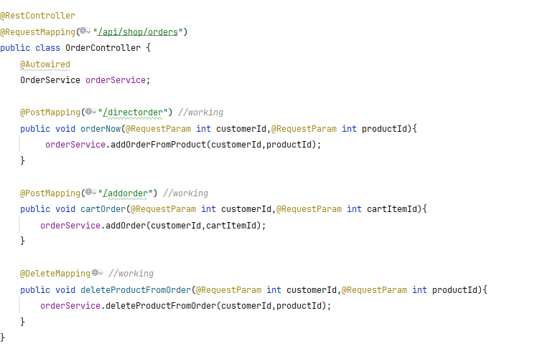
5) The controller package contains REST controllers that manage HTTP requests for the different entities in the e-commerce application, such as Cart, Customer, Order, and Product. These controllers act as intermediaries between the client and the service layer, handling incoming requests, invoking service methods, and returning responses.

Slide 11
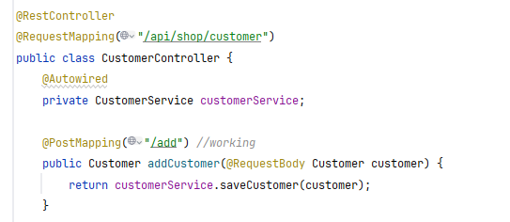
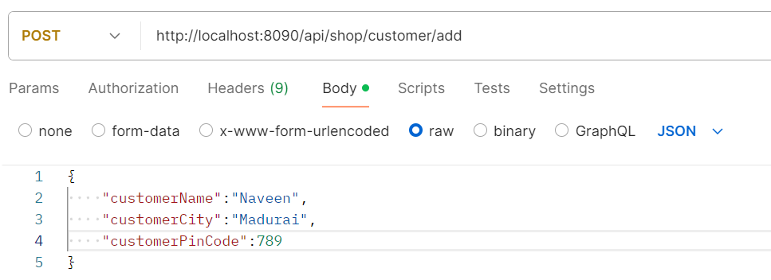
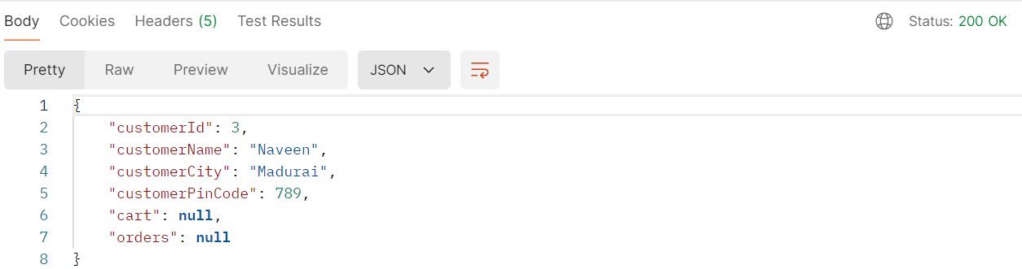
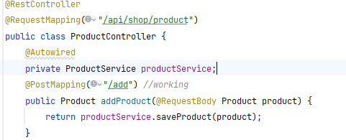
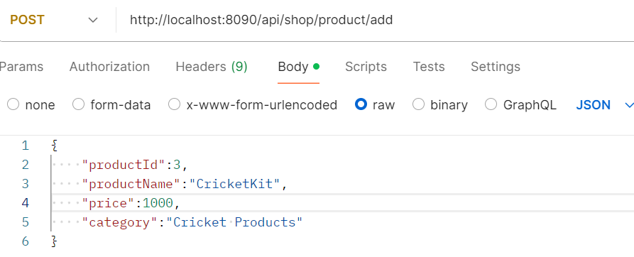
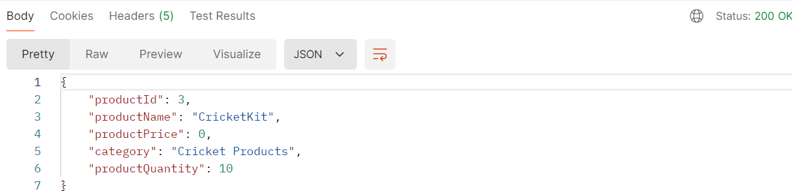
(ADDING CUSTOMER)
(ADDING PRODUCT)

Slide 12
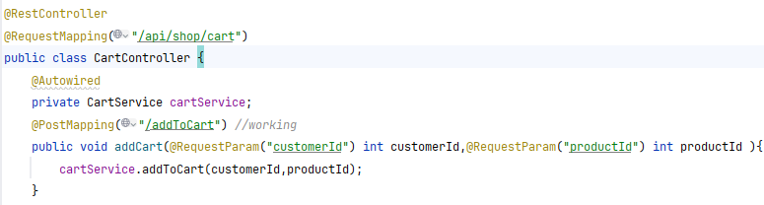
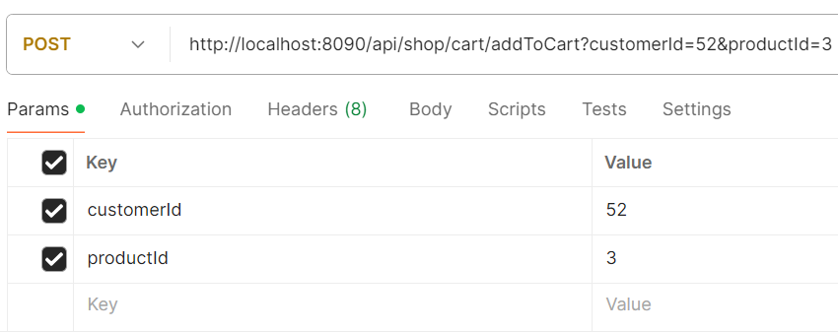
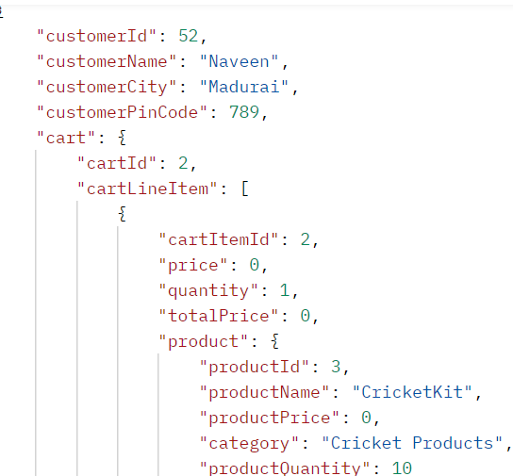

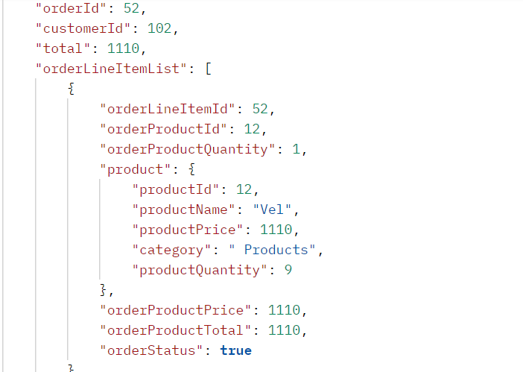
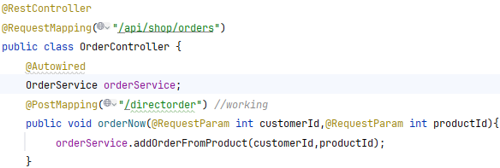
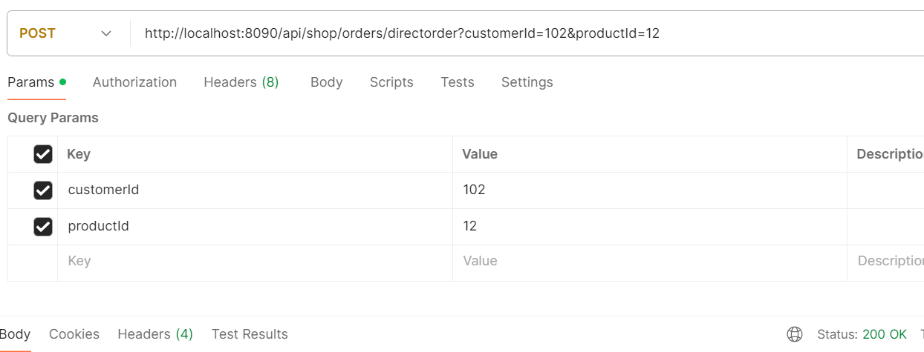
(addToCart using customer_Id =52 and product_Id=3)
(Making directorder using customer_Id=102,prod_Id=12)

Slide 13
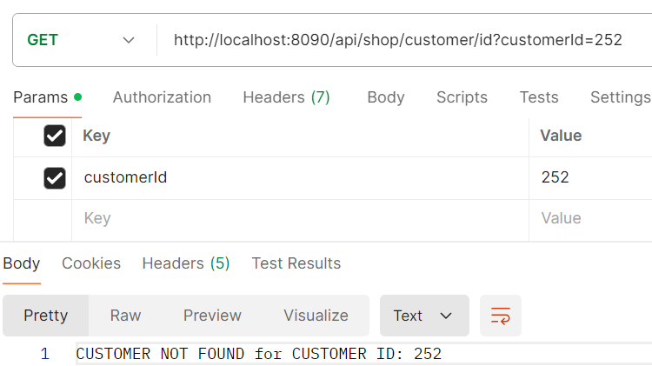
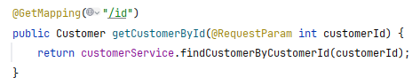
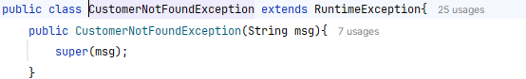
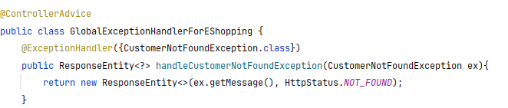
(Handling exception when that id is not found in CustomerTable)

Slide 14
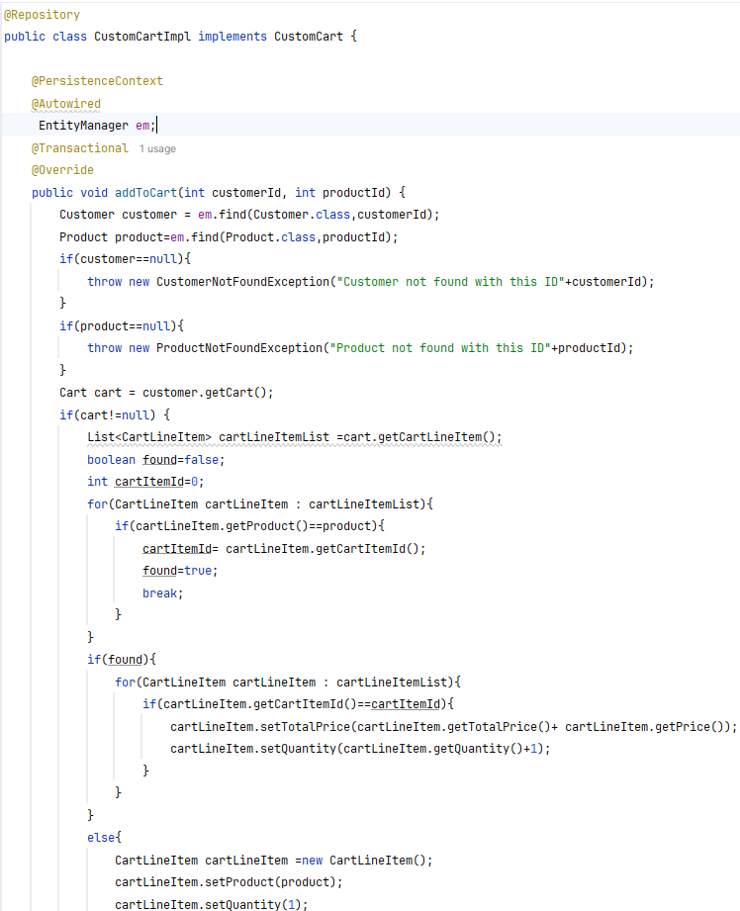

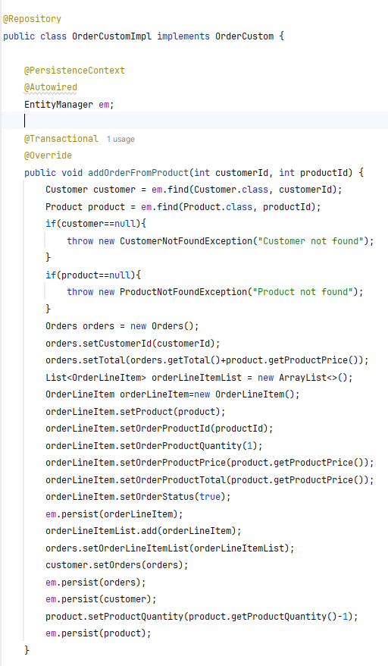
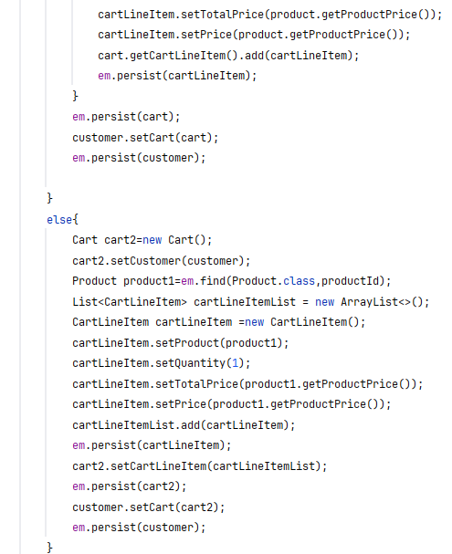
(Direct order from product)
(adding to cart)

Slide 15
Conclusion
The development of this e-commerce application using Spring Boot and Spring Data JPA has been a comprehensive and insightful experience, providing a deep understanding of modern Java-based web application development.
Including product management, user authentication, order processing, and search capabilities. The practical application of these technologies not only solidified my understanding of Spring Boot and Spring Data JPA but also enhanced my ability to design and develop scalable, maintainable, and efficient applications.
This capstone project has been instrumental in bridging the gap between theoretical knowledge and real-world application, equipping me with the skills necessary to tackle complex development challenges in the future.

Slide 16
Thank You

